Slide 1
VK graph analysis
Alyaxey Yaskevich

Slide 2
Data
Graph was extracted be means of http://vk.com/app3861133
This graph is provided by my friend, as soon as I don't use VK network actively. However, I can not add additonal attributes to nodes, because I don't know most of these people. Also, in data analysis and visualizations I use only first names and ID derivatives due to privacy considerations.

Slide 3
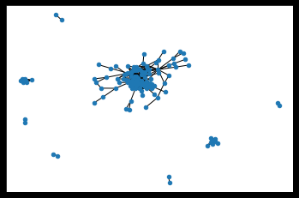
Graph summary
Number of nodes: 157
Number of edges: 501
Average degree: 6.3822
After removing isolates:
Number of nodes: 138
Number of edges: 501
Average degree: 7.2609

Slide 4
Node attributes
Unfortunately, recommended app which produced the graph cannot access all the attributes, as date of birth or city/country. Data of birth is accessible only for some users, but location is the same for all users.
Features provided for every node:
id
first name
last name
gender
personal relations status (most, but not every)

Slide 5
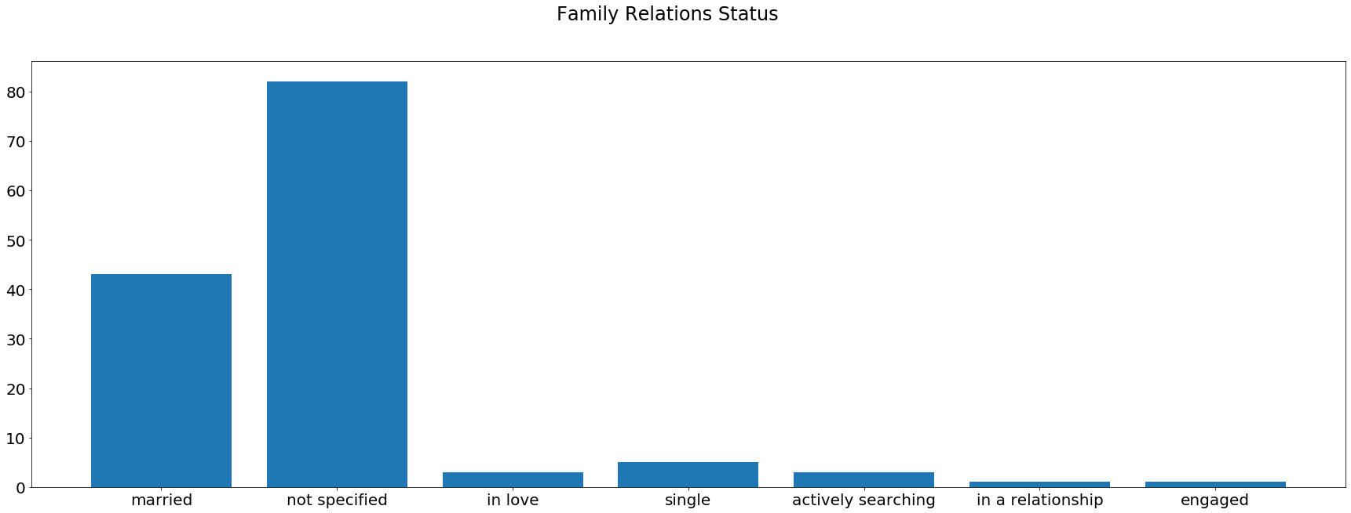
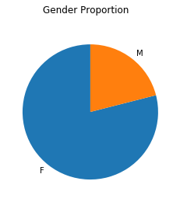
Node attributes

Slide 6
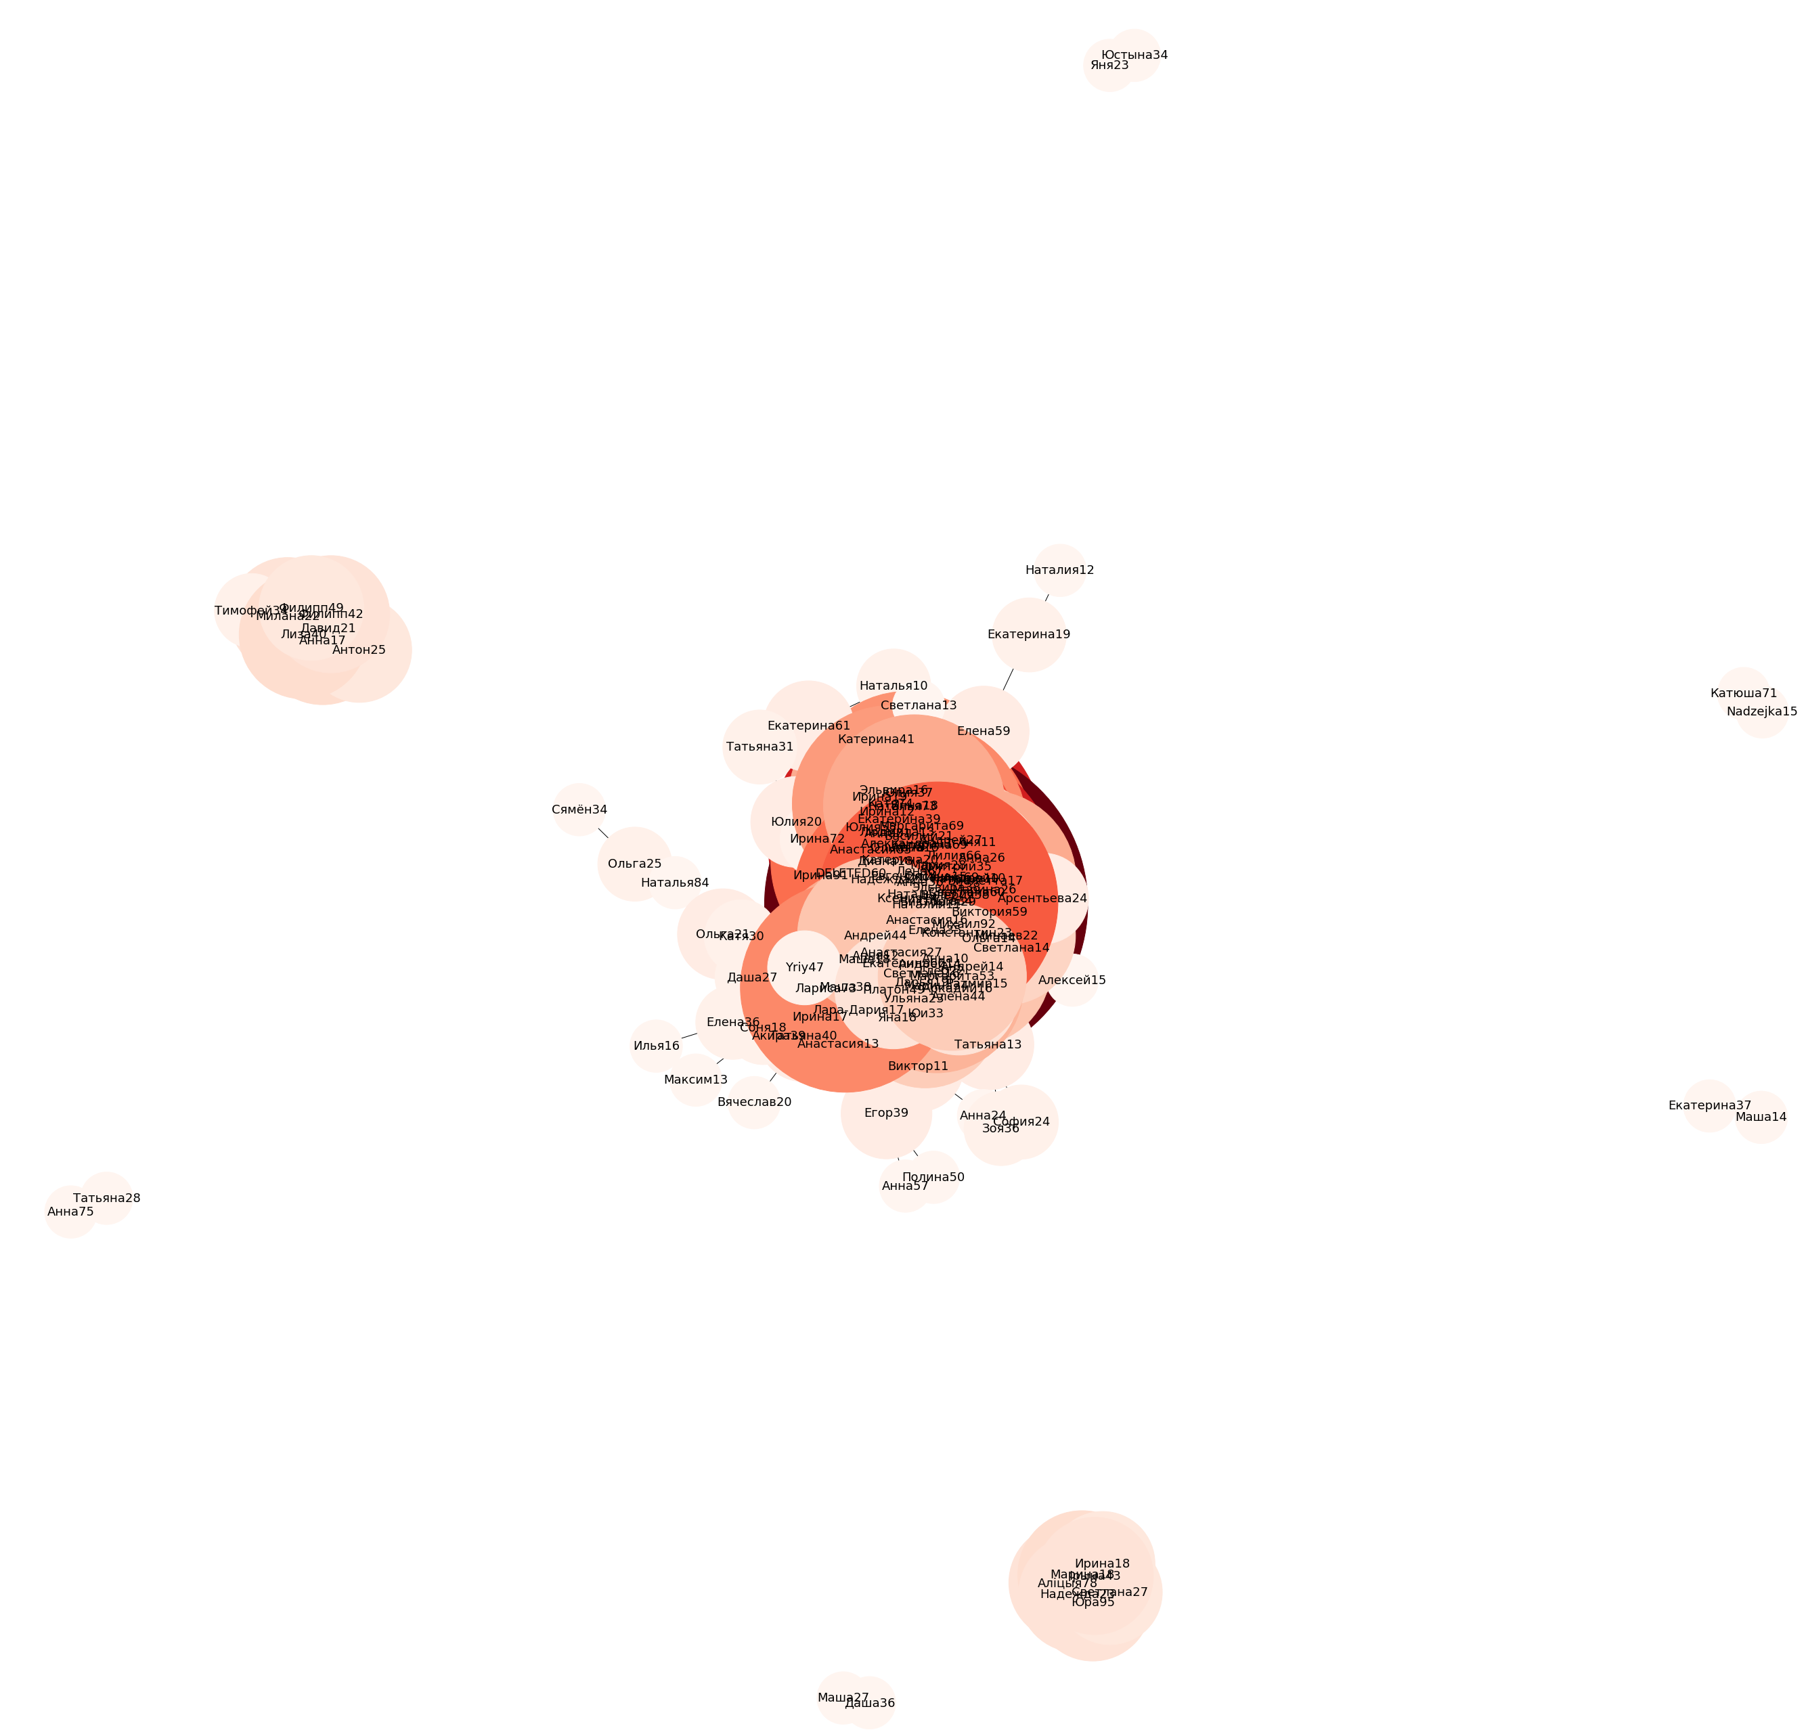
Network visualization (NetworkX)

Slide 7
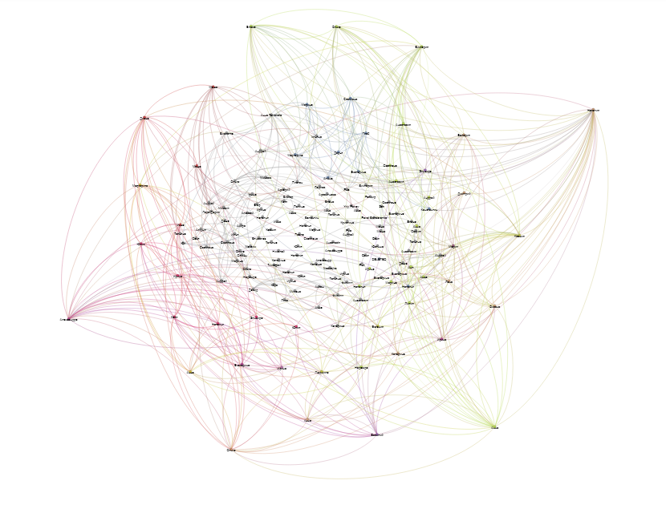
Network visualization (Gephi)

Slide 8
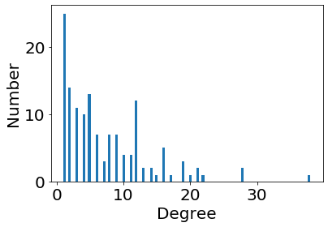
Network properties
Degree distribution
Max degree: 38
Mean degree: 7.3
Diameter: 8
Clustering Coefficient: 0.4

Slide 9
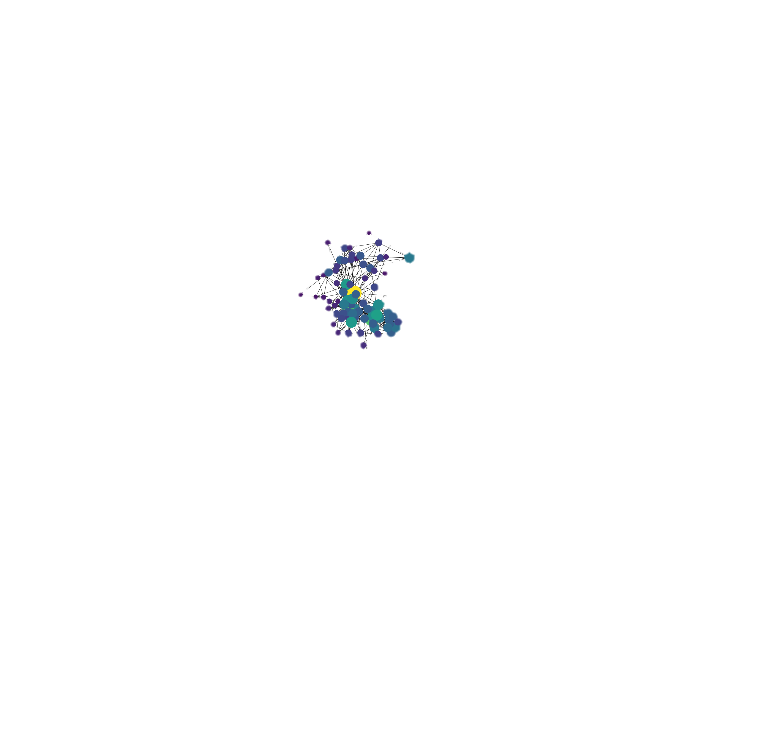
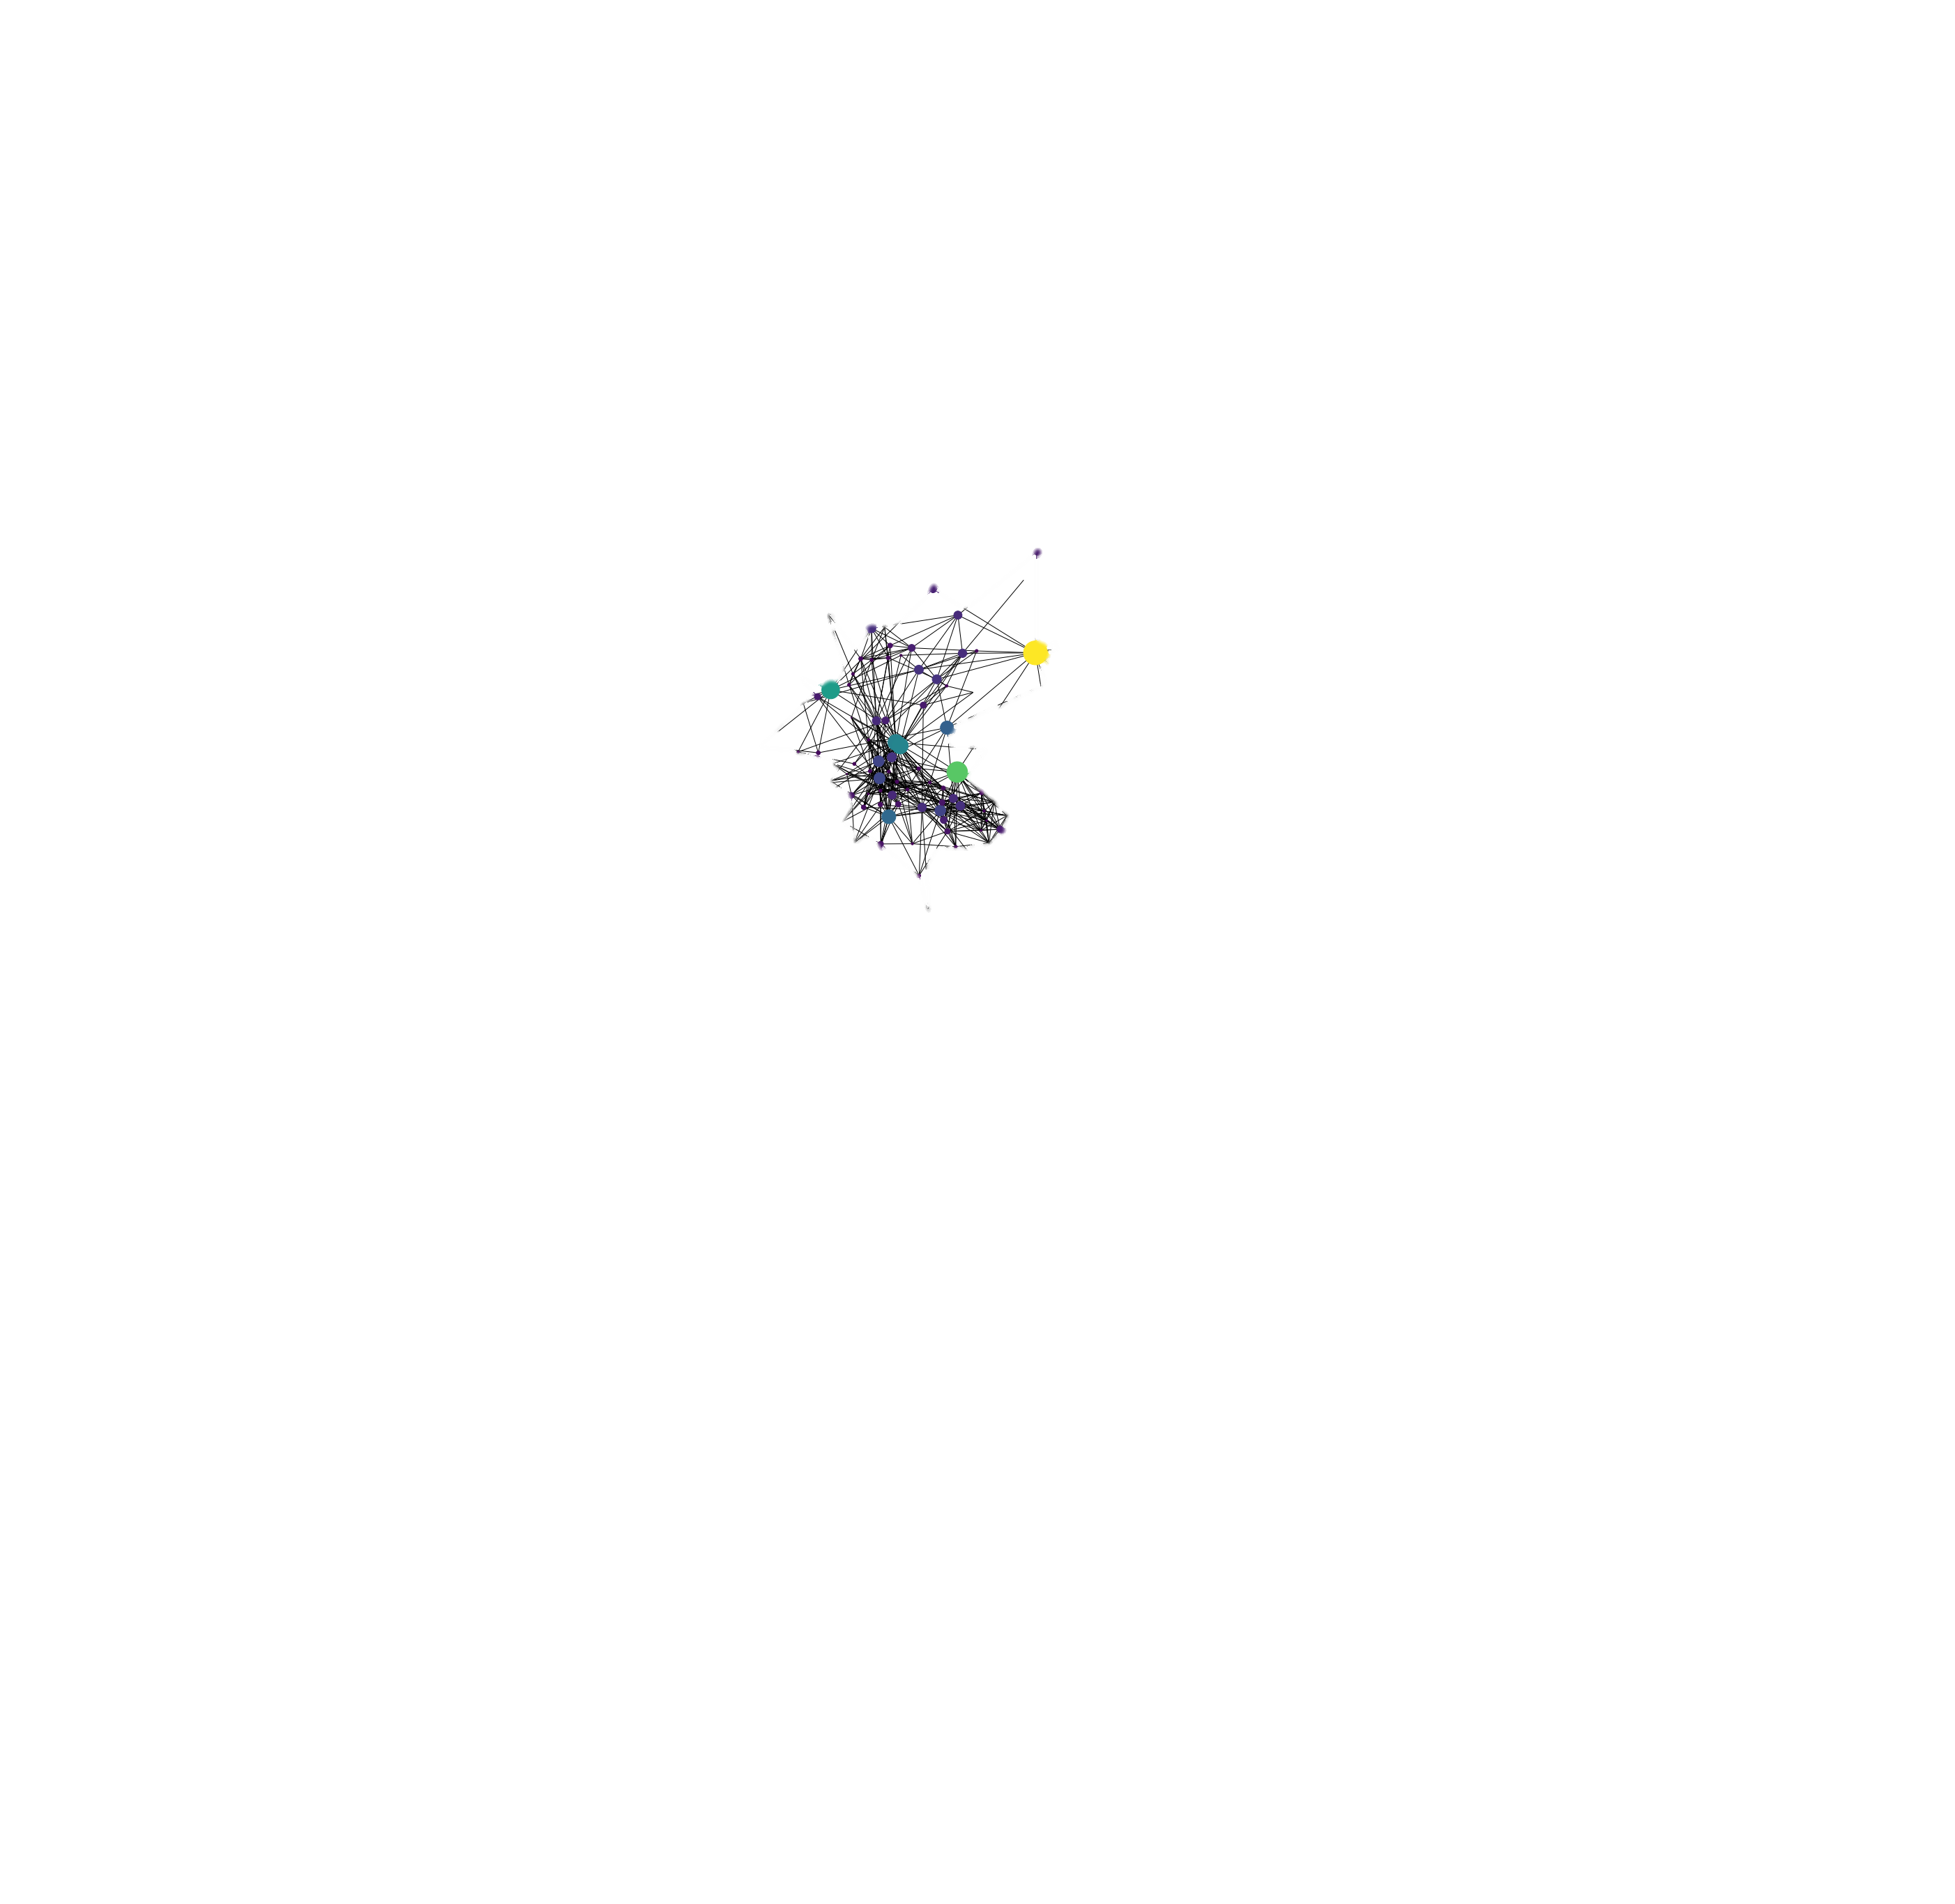
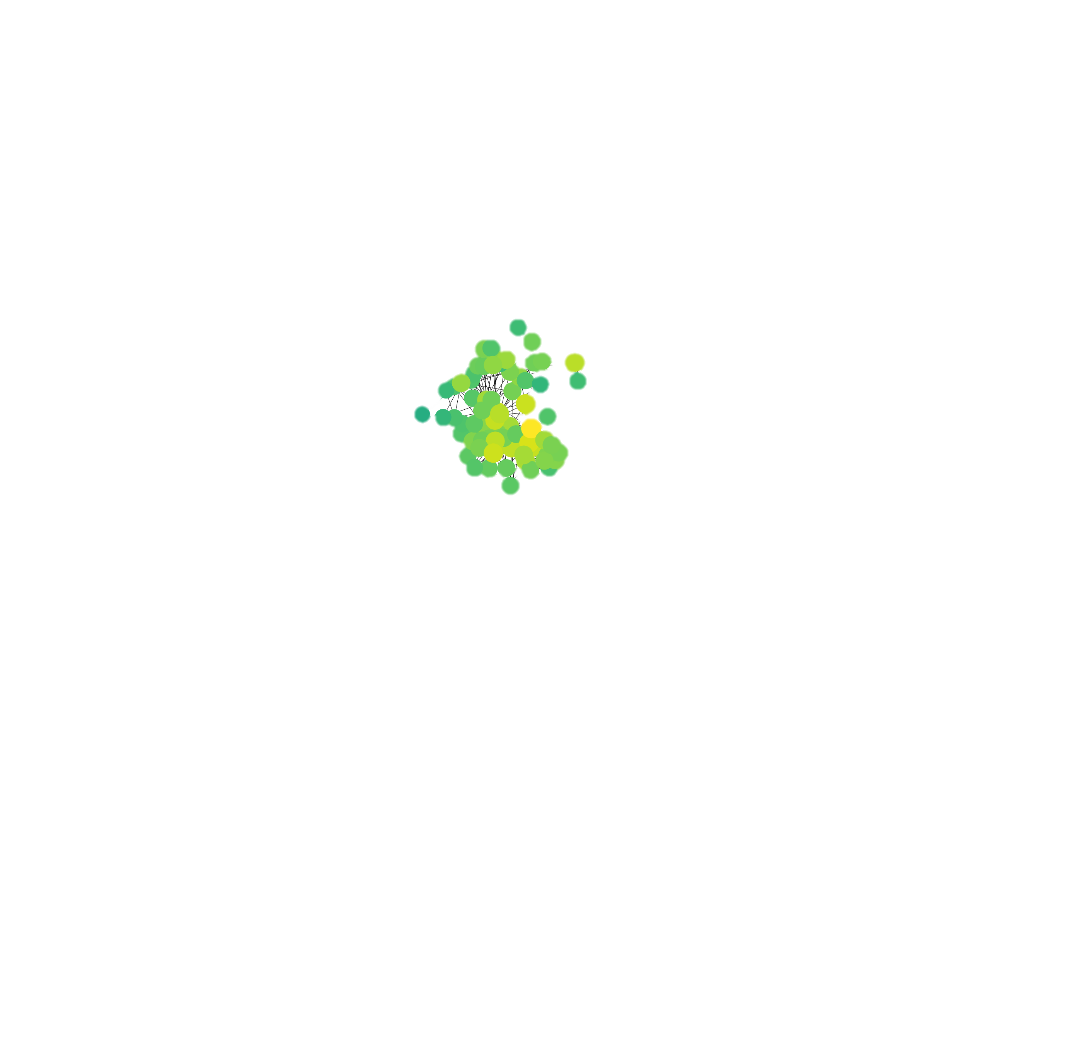
Degree vs Closenesess vs Betweenness

Slide 10
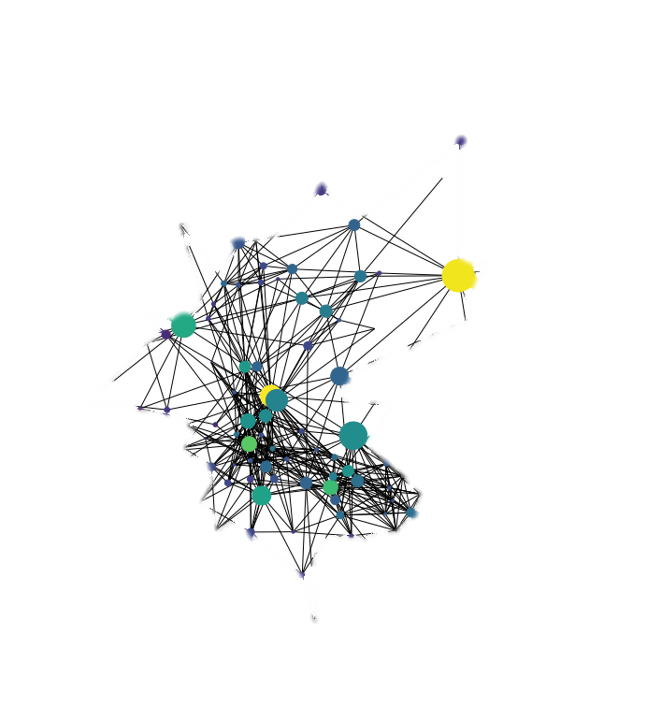
PageRank
Assortative Mixing
Degree assortativity coefficient: 0.16
Attribute assortativity coefficient (gender): 0.1
This attribute seems to be not really influential

Slide 11
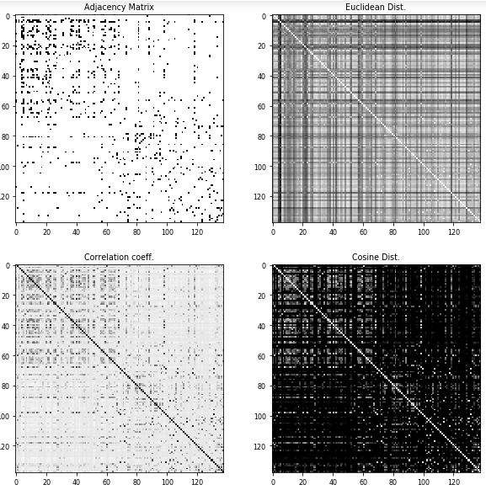
Node Structural Similarity

Slide 12
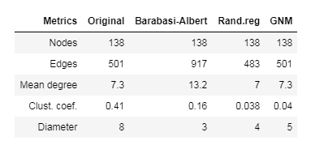
Comparison to random graphs
Despite there is no identical graph was generated via random graph algorithms, one could say that Random Regular Graph is the most similar to ours.

Slide 13
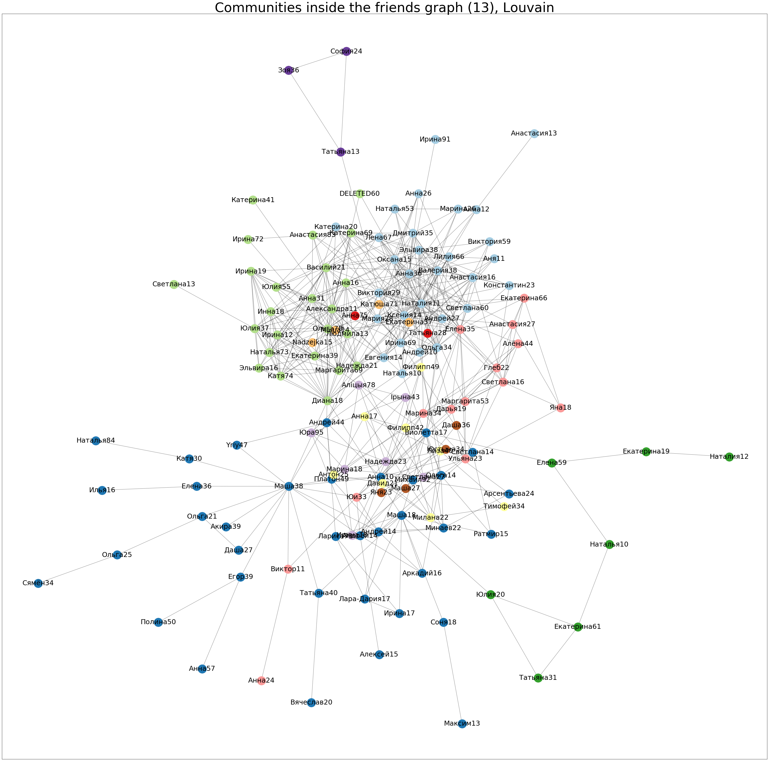
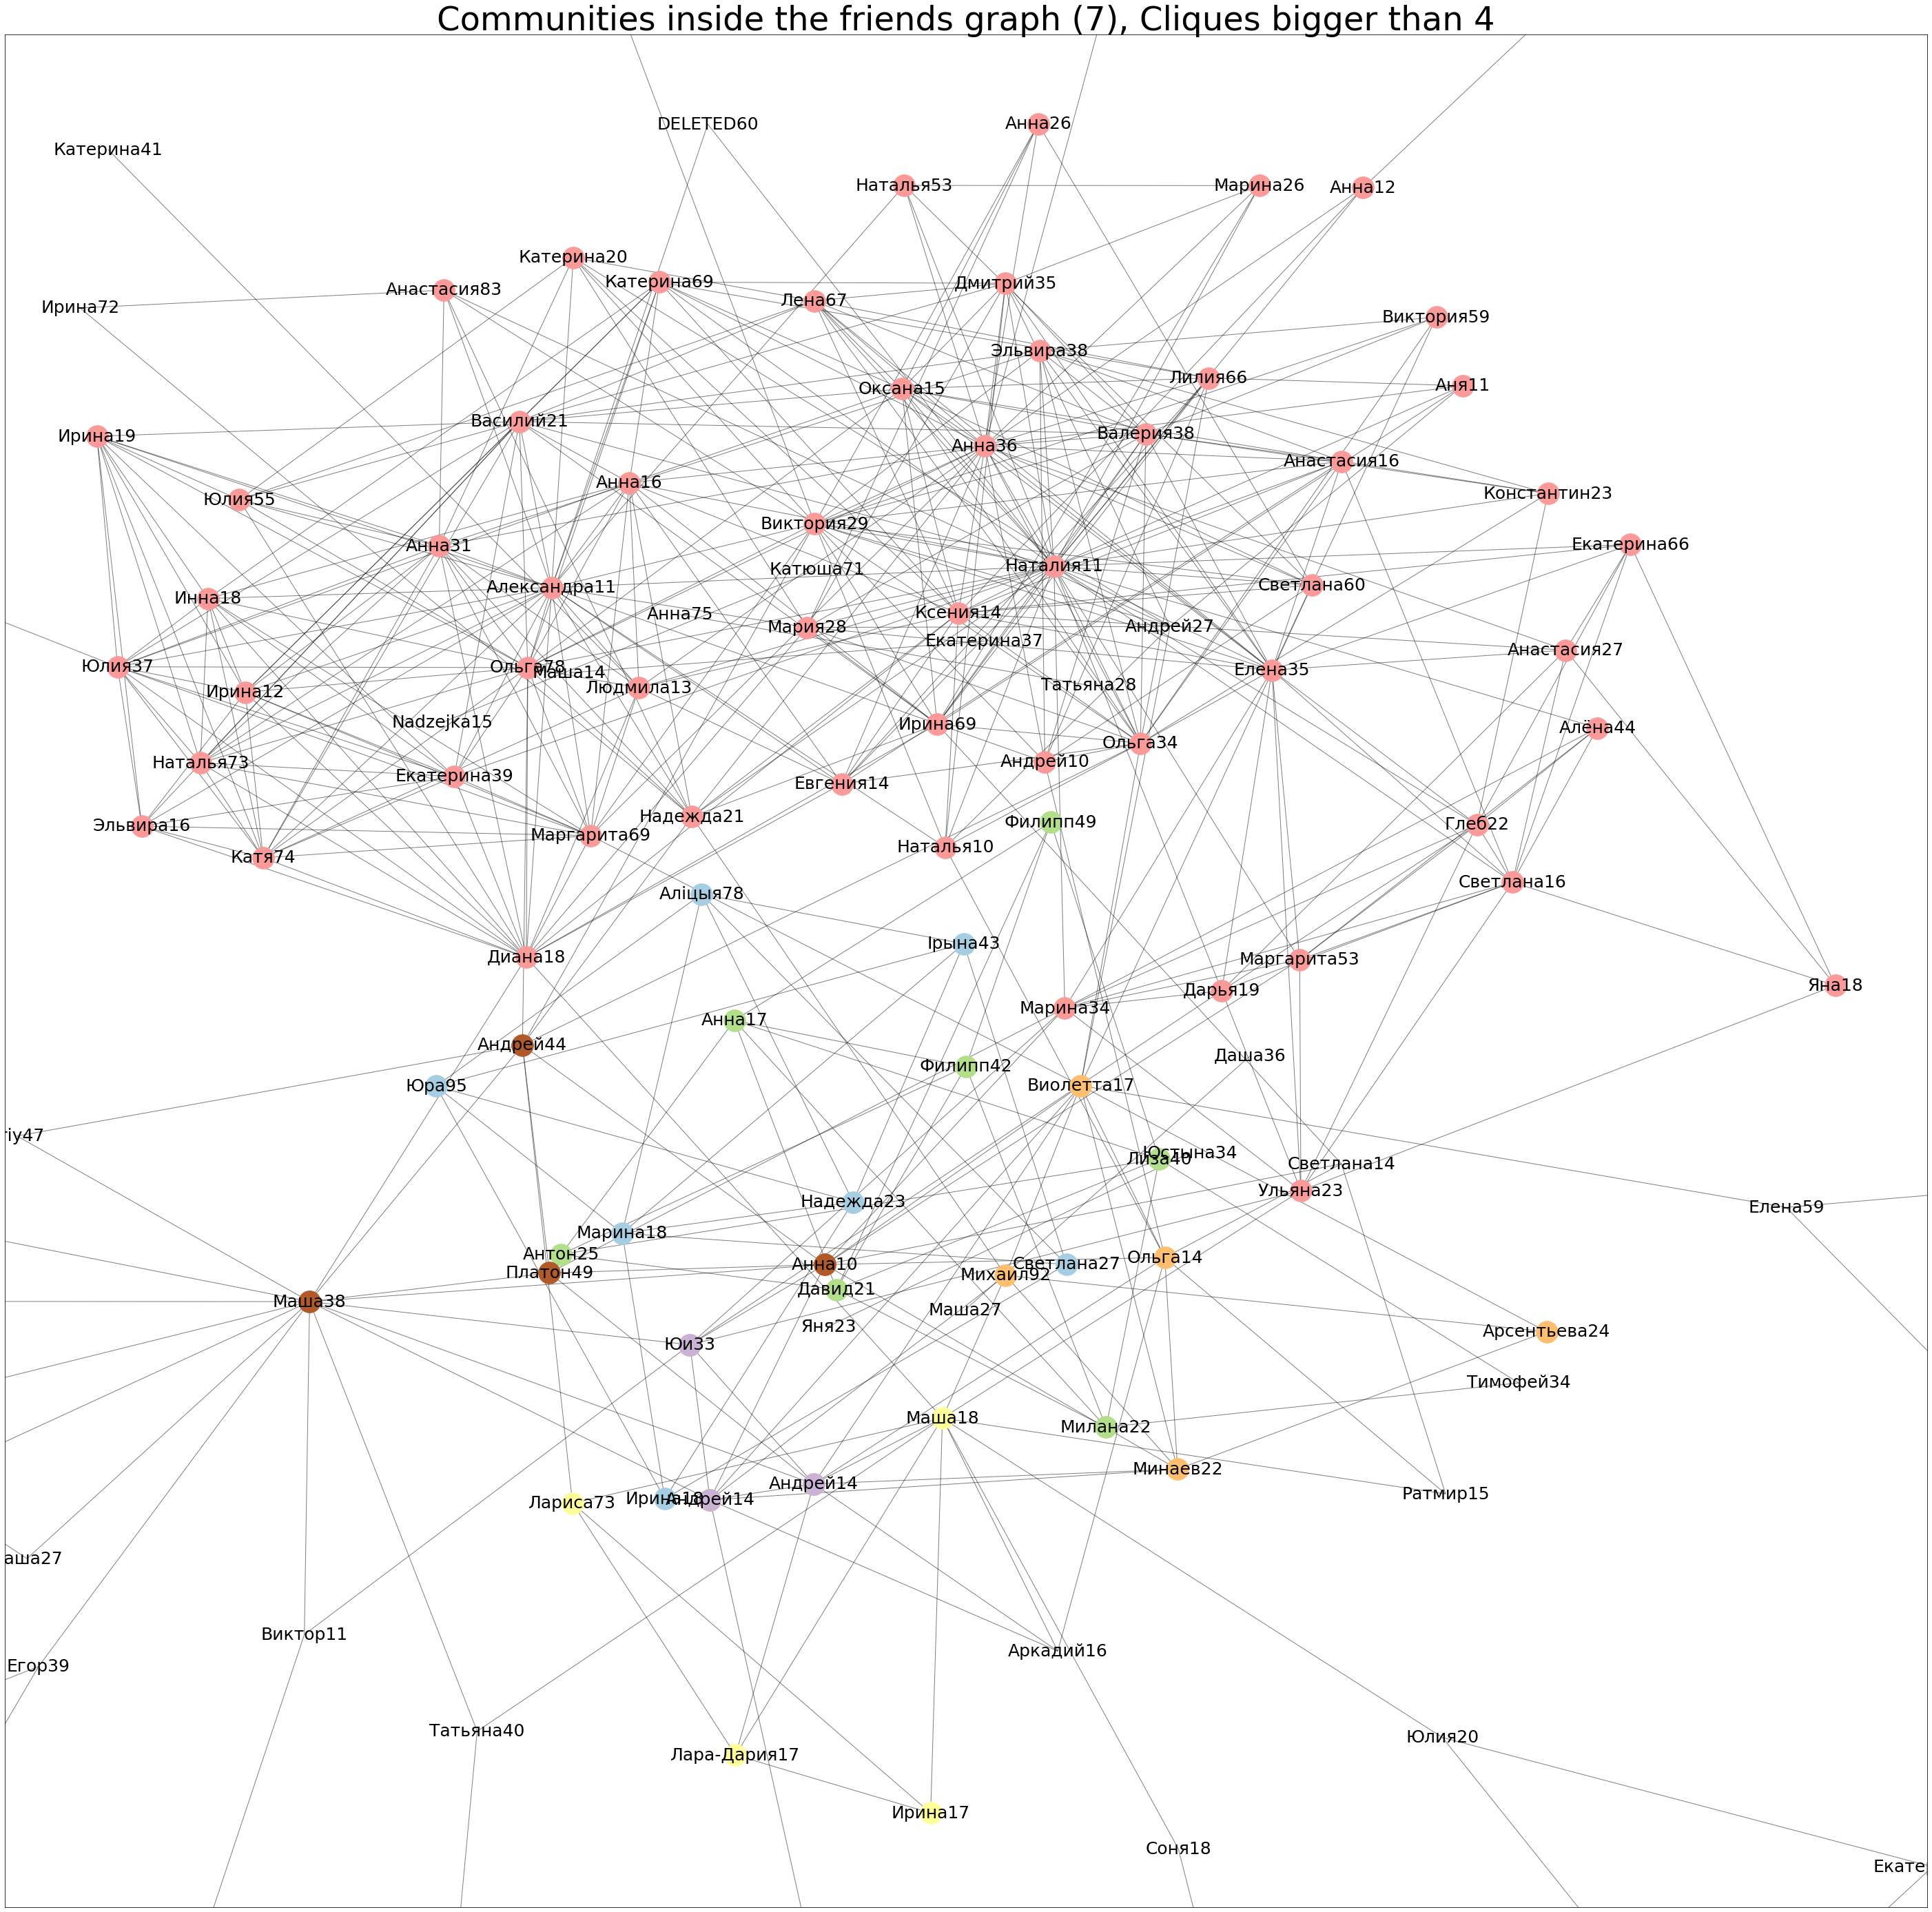
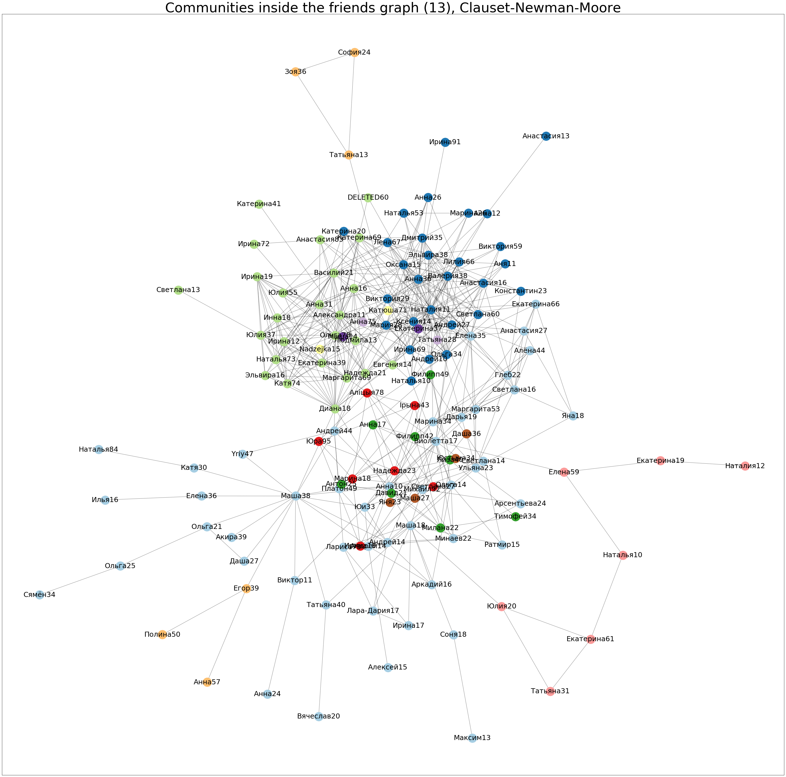
Communities

Slide 14
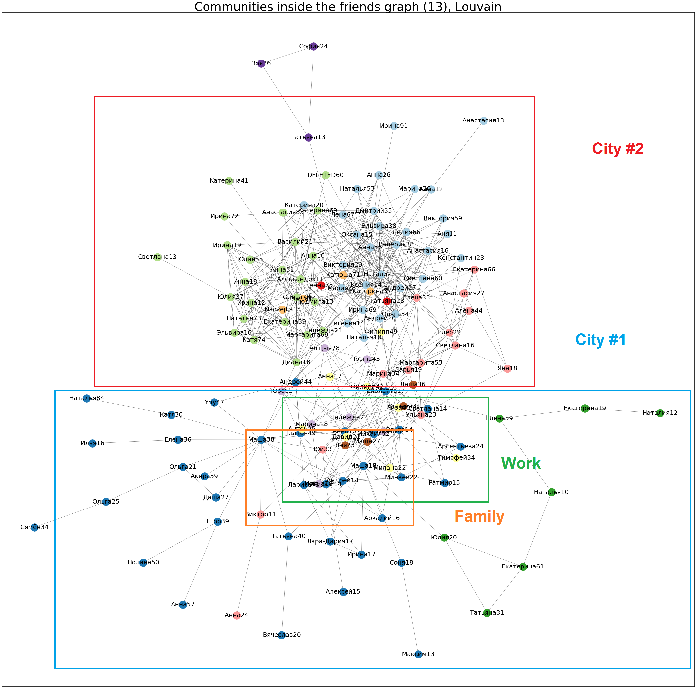
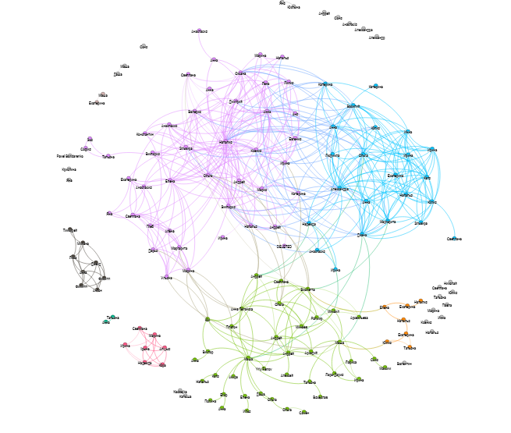
Gephi (clustering on modularity)

